Slide 1
Tenants Association
Software Testing

Slide 2
Automated Test
The automatic tests that we presented are automatic end to end tests, being executed automatic actions on the graphical interface.
We used the Selenium framework for the effective execution of actions.

Slide 3
Building test
First automated test is based on the building page
This test is implemented in order to see if the details of a building is added correctly in the building list.
In order to do that, first the user should log in to the site, go to add building details and then create the first building.
The test will pass if it find the data for the building that the user introduced.
Building details:
Street name
Street number
Building number

Slide 4
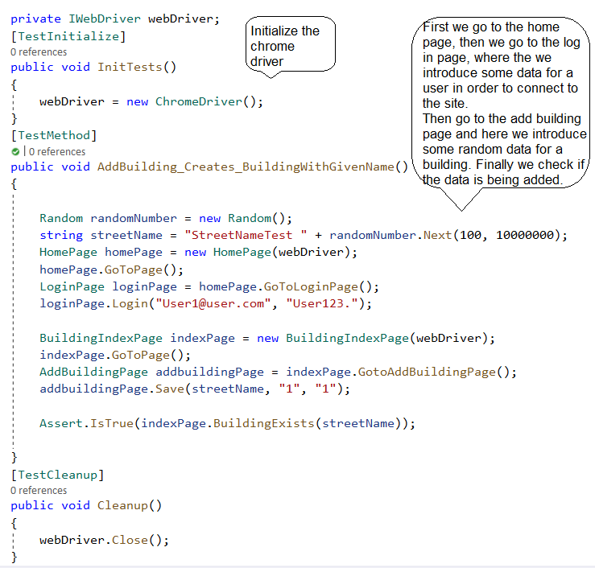
Steps:
Initialize the chrome driver
Open the site to the home page
Go on to the log in page and sign in a user
Go to the add building details page
Add random data for a building
See if the data that was introduce exists

Slide 5
Apartment Test
Second automated test based on the apartment details
Here, the same method is applied.
The test verify if the apartment details are introduced in the list.
In order to do that, first the user should log in to the site, go to add apartment details and then create the first apartment.
But the apartment model is link to the user model and to the building model.
So, when we create the apartment details, we do not need to allocate random data to some fields.
Apartment details:
Apartment number
User name
Building Id
Building number

Slide 6
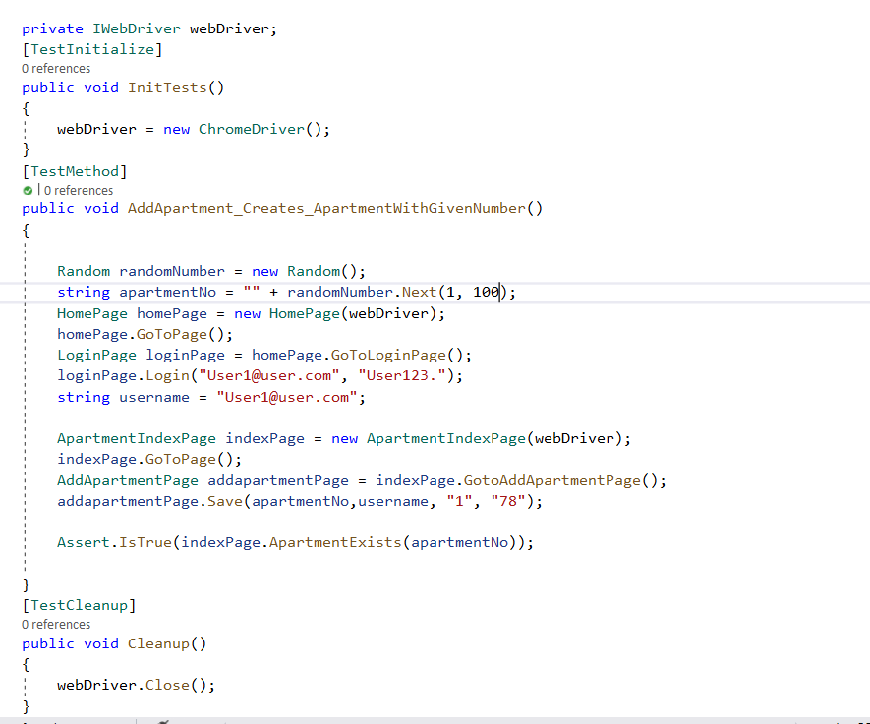
Steps:
Initialize the chrome driver
Open the site to the home page
Go on to the log in page and sign in a user
Go to the add apartment details page
Add data for a apartment. Here the username should be the same as for the email field in the log in page. And the building id can be 1.
See if the data that was introduce exists

Slide 7
Unit Tests
In computer programming, unit testing is a software testing method by which individual units of source code—sets of one or more computer program modules together with associated control data, usage procedures, and operating procedures—are tested to determine whether they are fit for use.
The goal of unit testing is to isolate each part of the program and show that the individual parts are correct.
Every unit test is composed from 3 parts:
Arrange
Act
assert

Slide 8
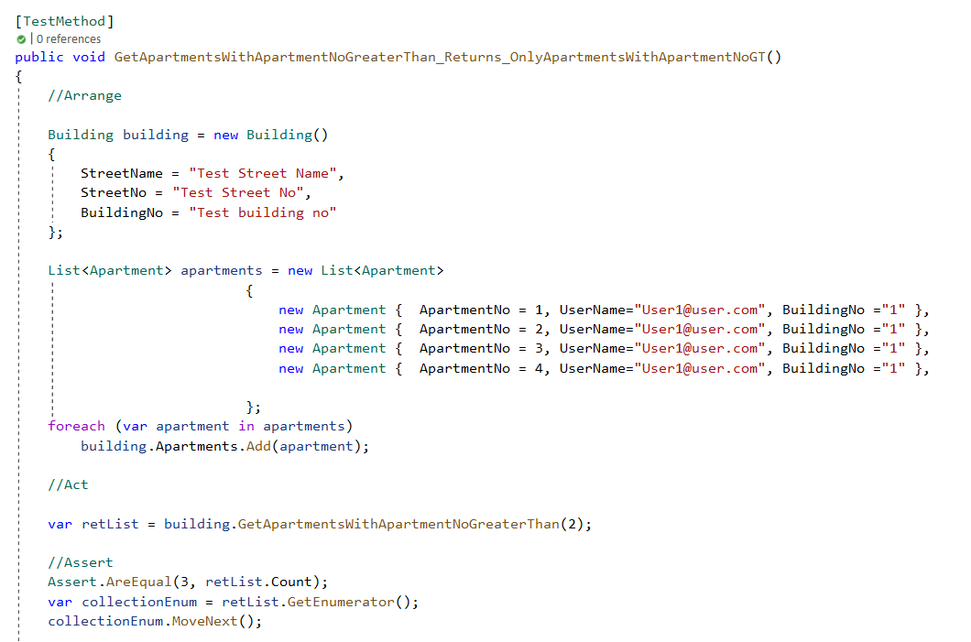
Unit test for apartments with apartment number grater then 2
For this method, you are supposed to introduce by hand some details regarding the building and a list of apartments.

Slide 9
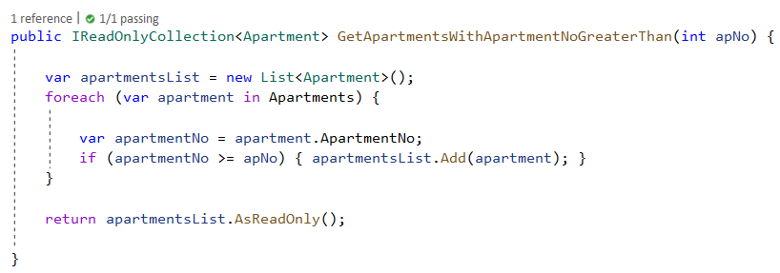
After that, in the Building model, there is implemented the method that computes if the apartment number is >= 2.
In the assert part, it is verify if the number of apartments with their apartment number >= 2, is the expected one.

Slide 10
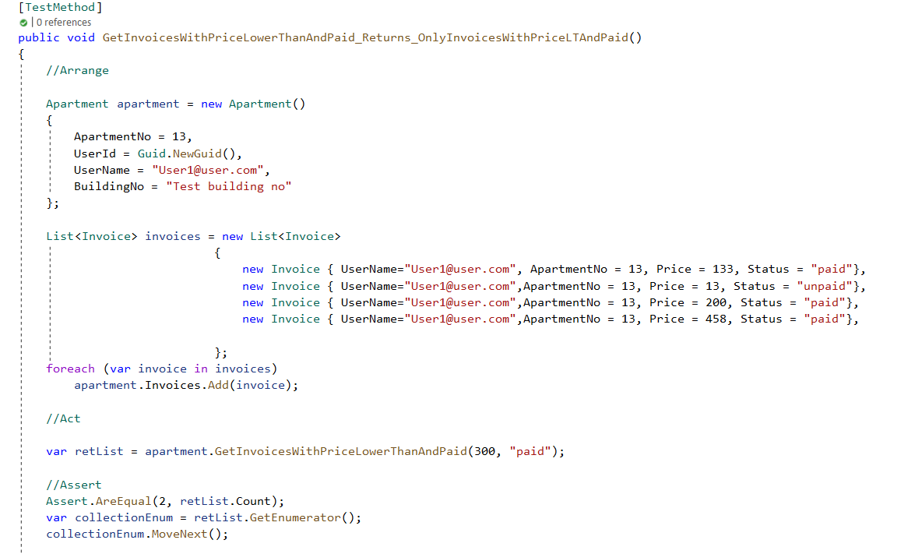
Unit test for paid invoices with price lower then 300$
For this method, you are supposed to introduce by hand some details regarding the apartments and a list of invoices.
The fields that are important for one invoice are: price and status.

Slide 11
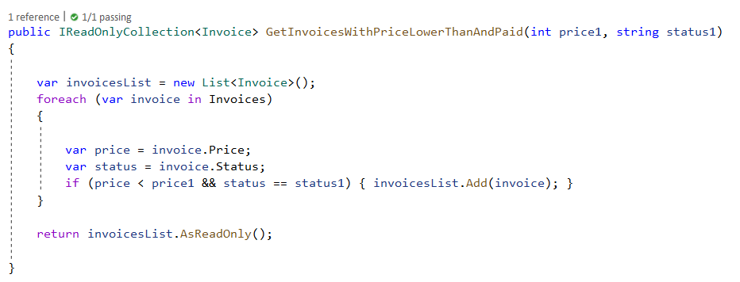
After that, in the Apartment model, there is implemented the method that computes if the invoice price is <300 and it is paid.
In the assert part, it is verify if the number of paid invoices with their price < 300, is the expected one.

